Slide 1
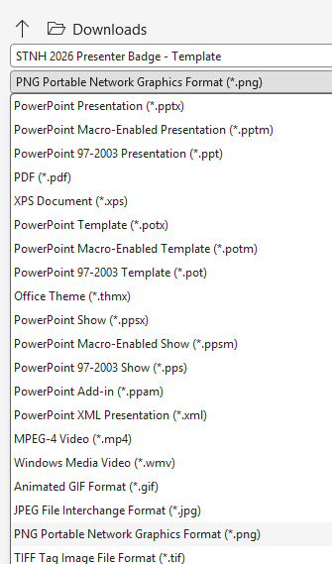
INSTRUCTIONS
START HERE: INSTRUCTIONS
How to create your Presenter Badge
NCURA REGION V | FALL 2026 MEETING
1
Pick your badge
Slide 2 includes a headshot frame. Slide 3 has no photo. Use one and ignore the other.
2
Add your session details
Click [Presentation Title] and [Presentation Date] and type over them, brackets included. You may adjust font size only if your presentation title does not fit in the designated space.
3
Add your headshot (Slide 2 only)
Click the picture icon in the frame and choose your photo. You may resize the image frame if needed.
4
Export the badge as an image
Windows: File > Save As > PNG > Just This One.
Mac: File > Export > PNG > Save Current Slide Only.
5
Share it with your network
Add the PNG to your email signature or post it on LinkedIn and other social media to announce your session!

Slide 2
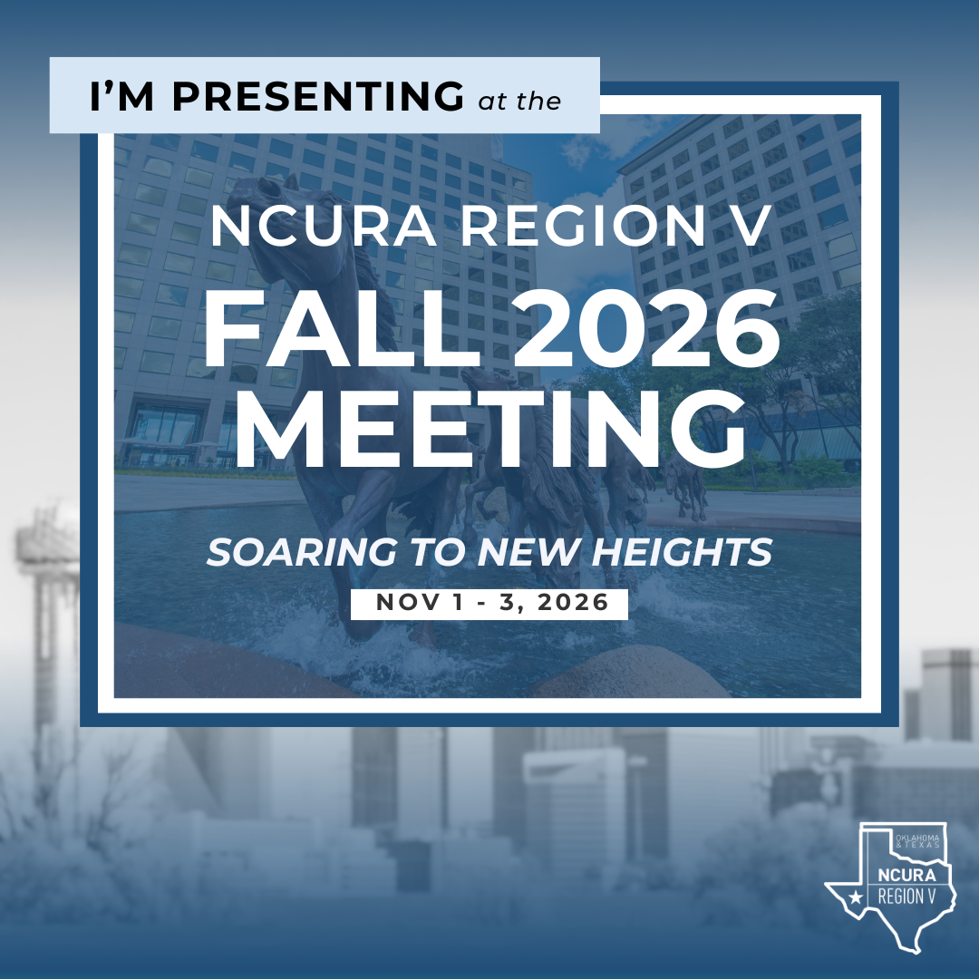
HEADSHOT TEMPLATE
[Presentation Title]
[Presentation Date]

Slide 3
NO HEADSHOT TEMPLATE
[Presentation Title]
[Presentation Date]

